Slide 1

Big Data Analytics in Healthcare: Practical Use Cases
Seminar Timing: Wednesday [3:00pm-5:00pm]
Group no: A06
Room No: LX608
Tutor Name: Ms Alaa
Presented By:
Prasanna Gautam
Student ID: 260016207

Slide 2


Cloud-Based Hospital Bill Prediction System
Problem Statement
Hospital bills are difficult to estimate
Patients lack cost transparency
Hospitals require financial planning tools
Project Objective
Predict hospital billing cost using Machine Learning
Build scalable cloud analytics solution
Enable real-time cost prediction

Slide 3
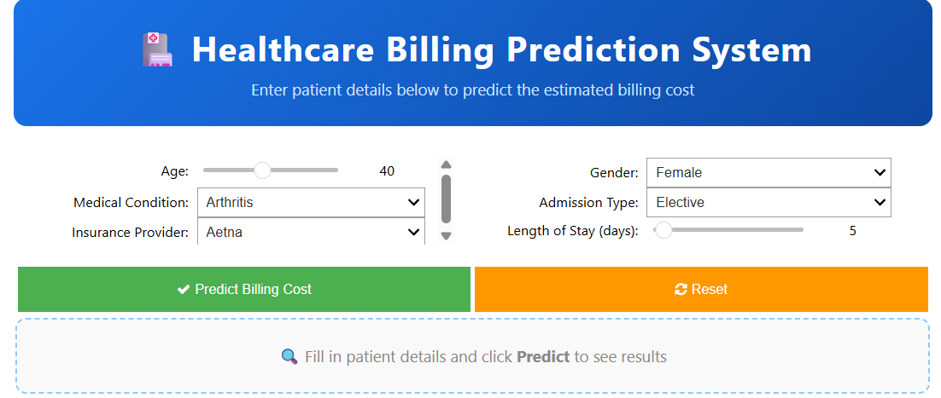
Proposed Solution
Azure Cloud + Big Data Analytics
Machine Learning billing prediction model
Real-time deployment via API
Expected Benefits
✔ Better patient financial awareness
✔ Hospital resource optimisation
✔ Data-driven healthcare decisions

Slide 4
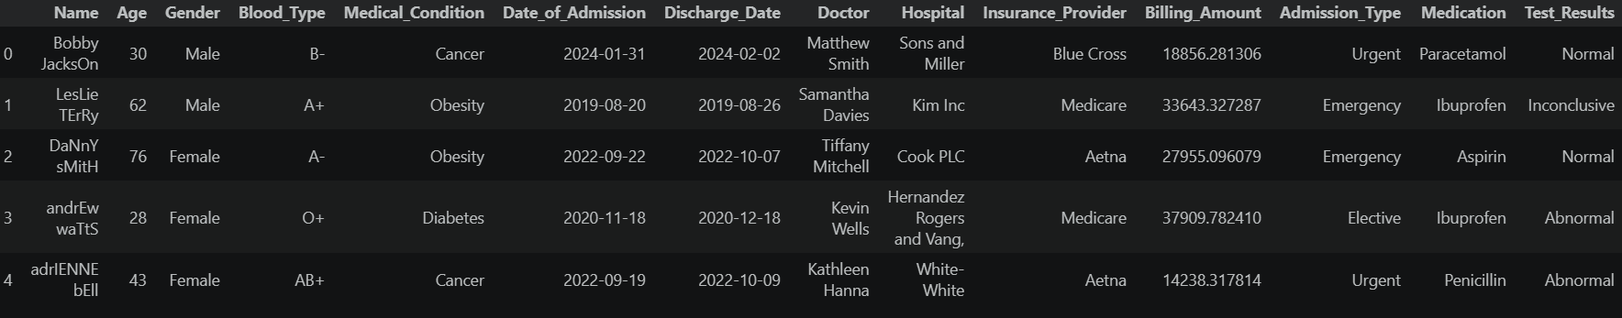
Healthcare Dataset Overview
Dataset Source
Healthcare Dataset (Kaggle)
Realistic hospital admission data
Why Selected
Contains billing influencing factors
Suitable for cost prediction
Structured healthcare data
Supports ML & cloud analytics
Dataset Summary
Records: 55,000+ patients
Features: 15 columns
Format: CSV structured dataset
Target Variable: Billing Amount

Slide 5
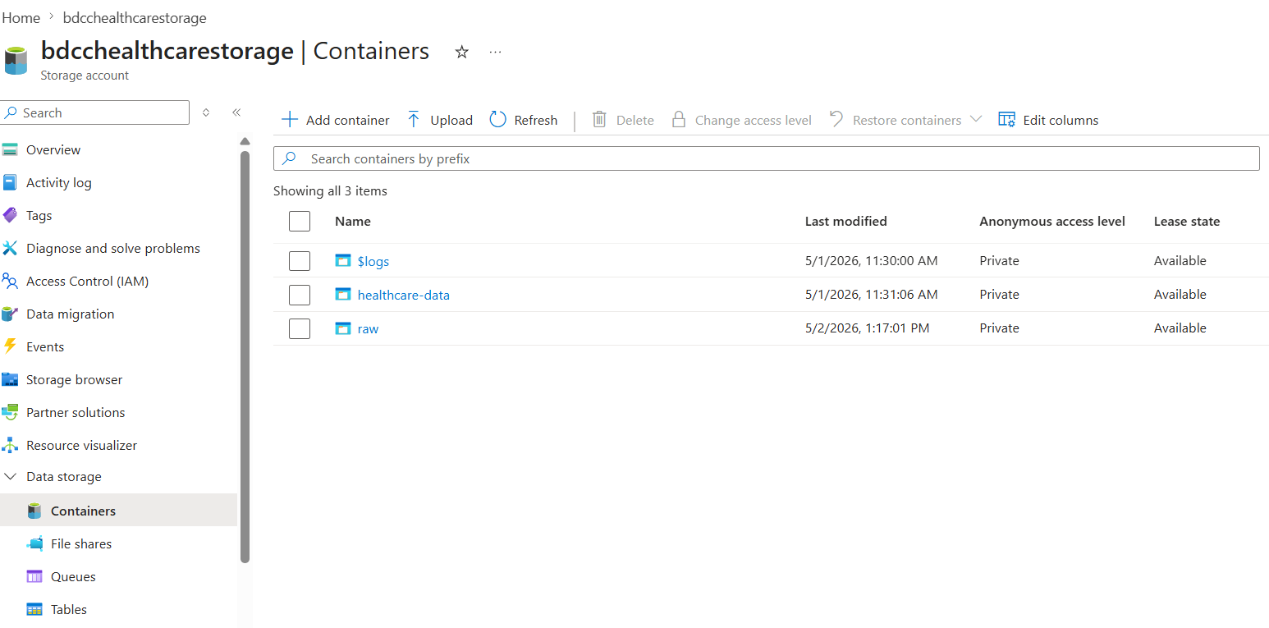
Data Ingestion and Cloud Storage Design
Cloud Storage Solution
Azure Data Lake Storage Gen2 (ADLS)
Scalable & distributed storage
High availability and redundancy
Cost-efficient pay-as-you-go model
Data Ingestion Process
Azure Synapse Pipeline used
Delimited Text Dataset created
Automated data copy to Data Lake
Raw data stored in Raw Layer

Slide 6
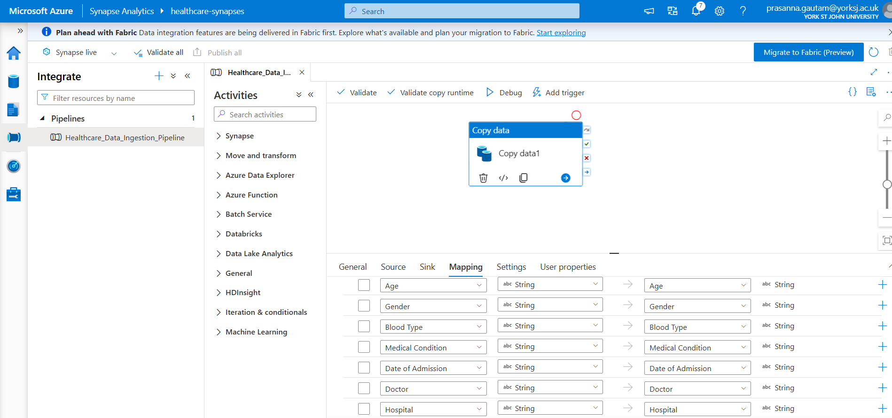
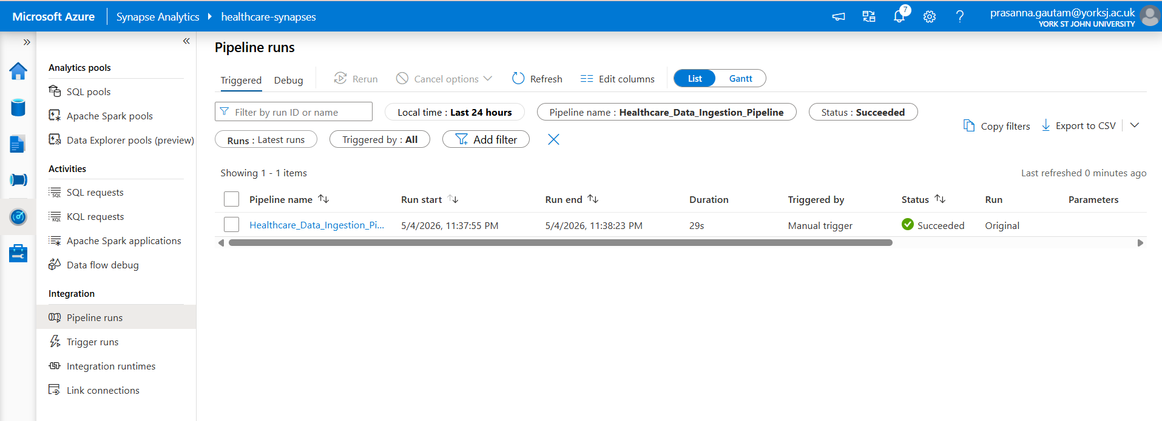
Storage Architecture
Raw Layer → Original dataset
Processed Layer → Cleaned data
Analytics Layer → ML & Reporting
Why Azure Storage?
Supports Big Data workloads
Integrated with Databricks & Azure ML
Secure access using IAM & RBAC
Industry-standard cloud architecture

Slide 7
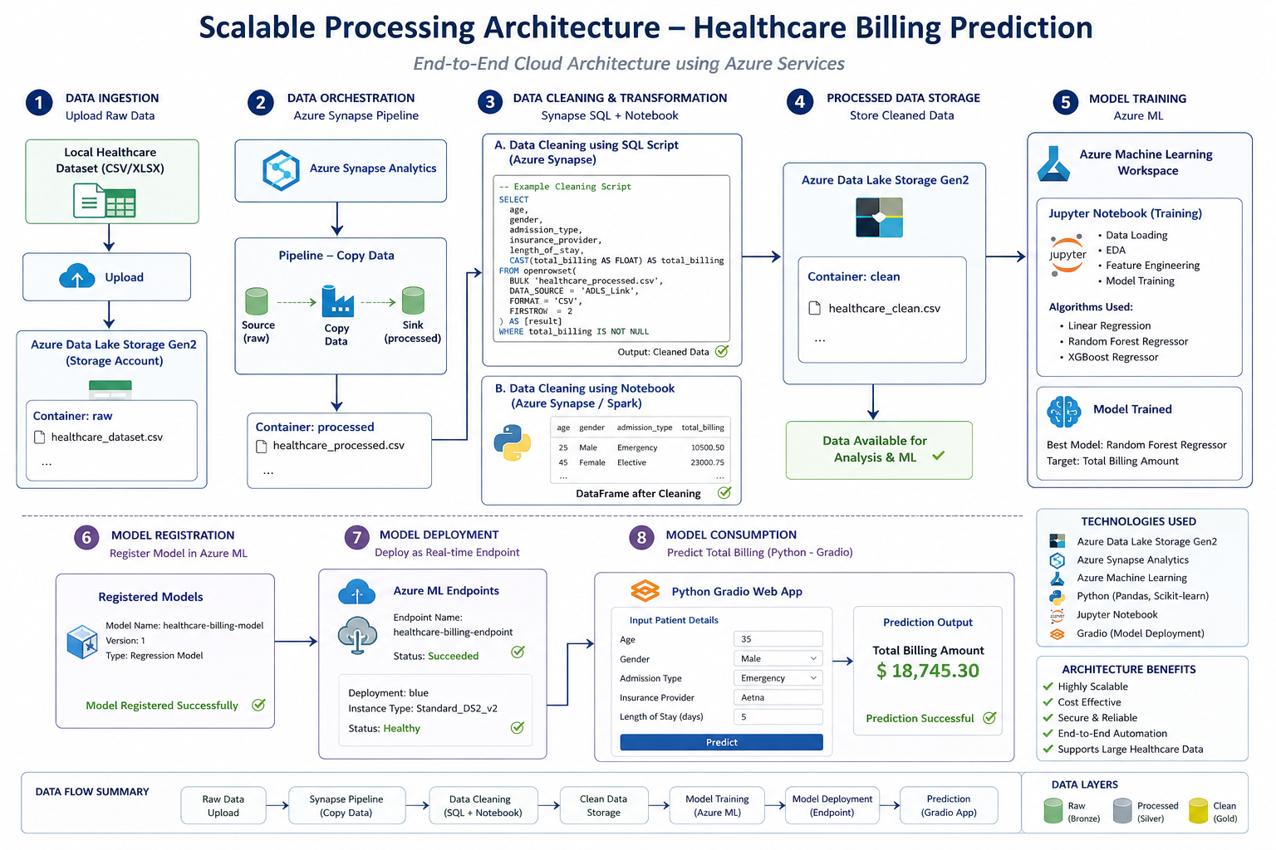

Slide 8
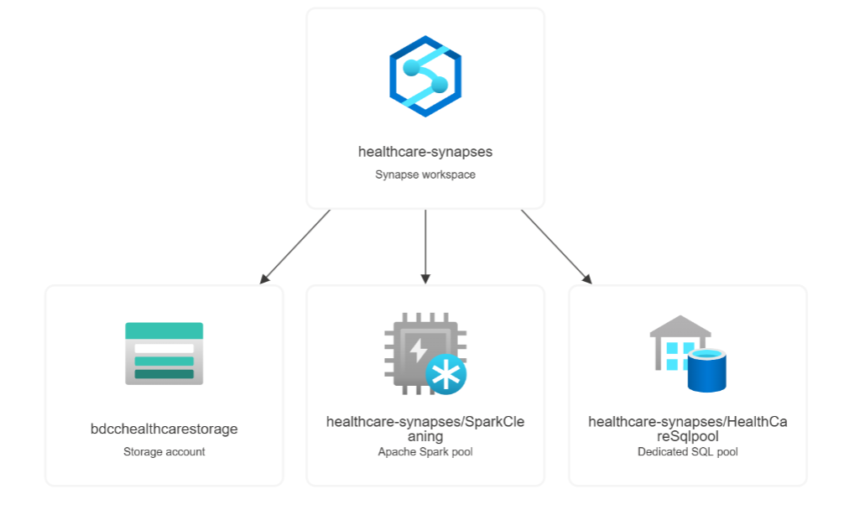
Data Extraction & Pre-processing
Data Sources & Tools Used
Data Source
Healthcare Billing Dataset (CSV format)
Extraction Tools
Azure Data Lake Storage Gen2
Azure Synapse Analytics Pipeline
Synapse Notebooks (Spark / Python)

Slide 9
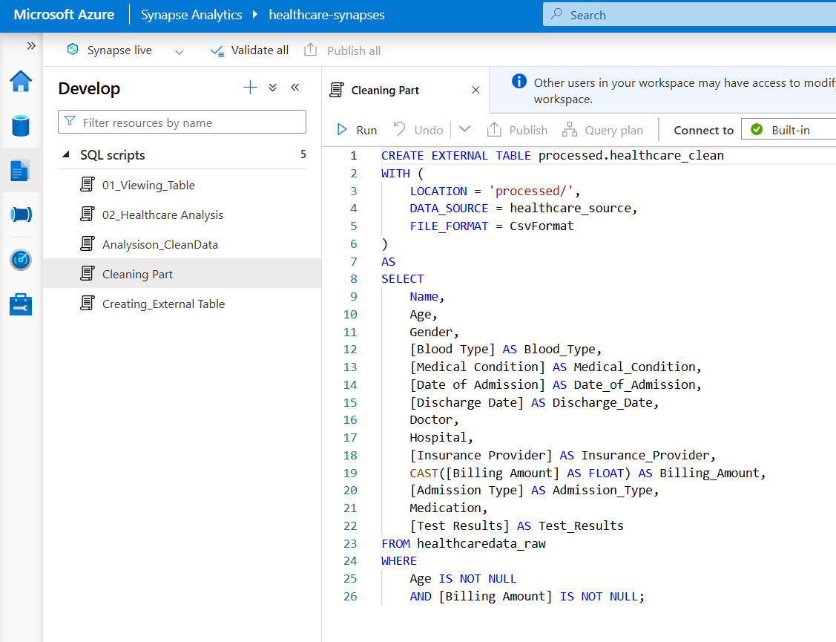
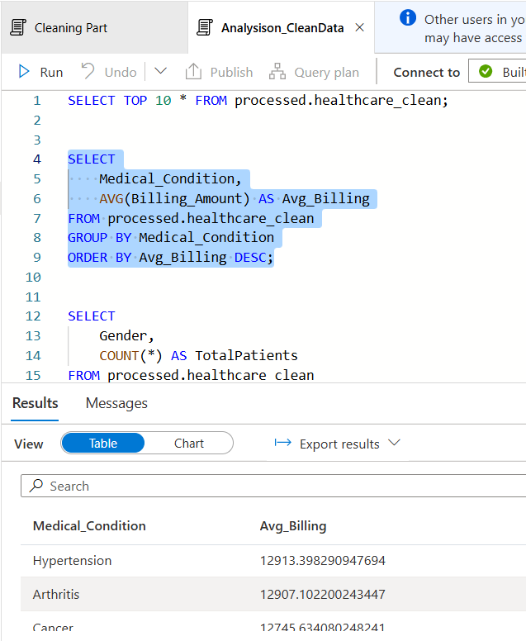
Data Cleaning
Removed missing/null values
Handled inconsistent records
Removed duplicate patient entries
Data Transformation
Converted categorical variables into numerical format
Standardized feature formats
Normalized billing-related attributes
Feature Engineering
Selected important billing predictors:
Age
Gender
Admission Type
Length of Stay
Insurance Provider

Slide 10
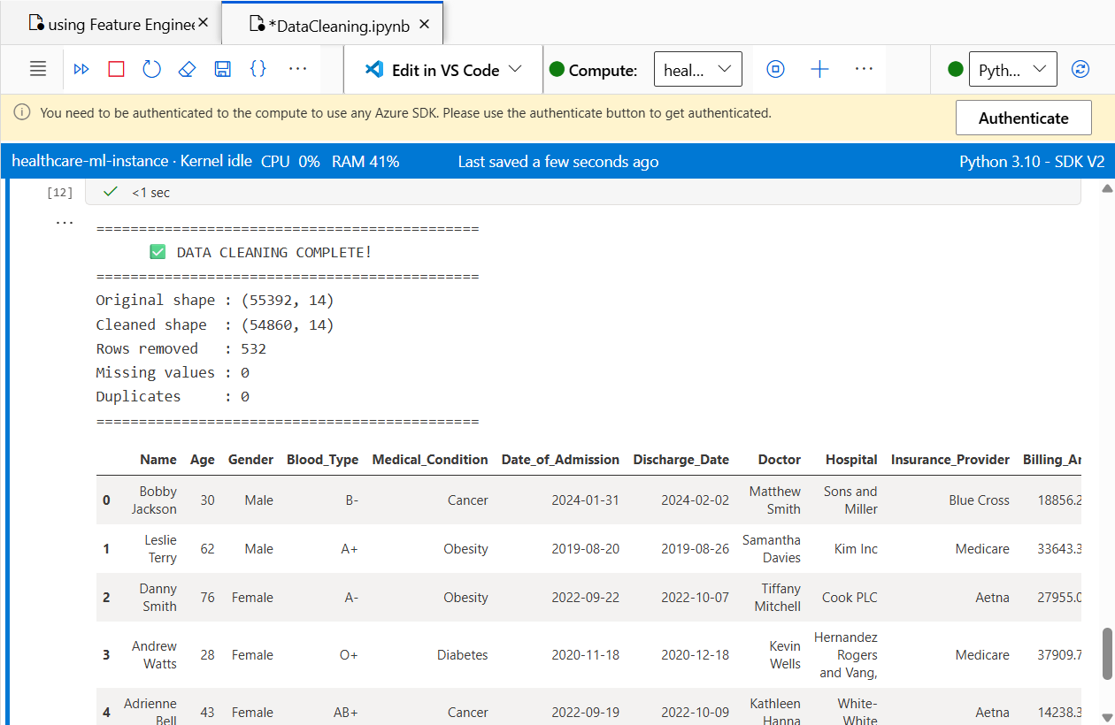
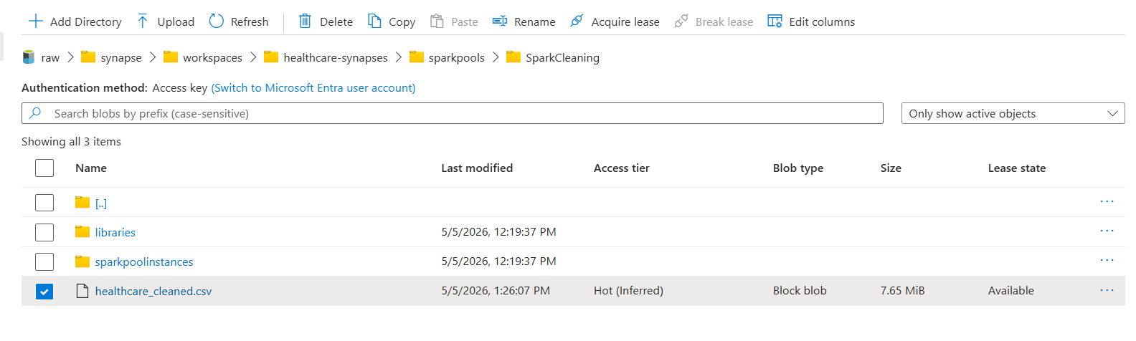
Data Preparation
Split dataset into:
Training Data
Testing Data
Output of Pre-processing
Clean structured dataset generated
Stored back into ADLS Gen2 clean container
Data ready for:
Machine Learning Training
Predictive Analytics

Slide 11
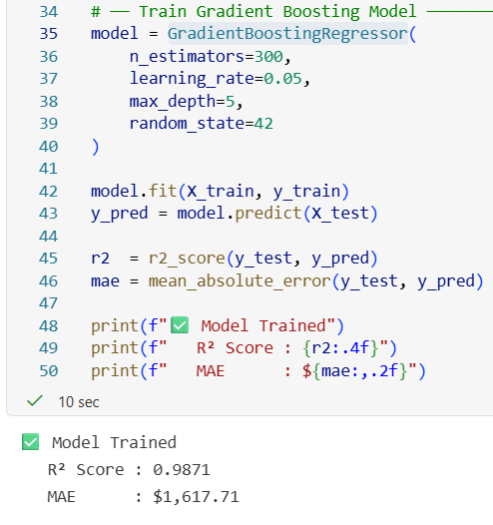
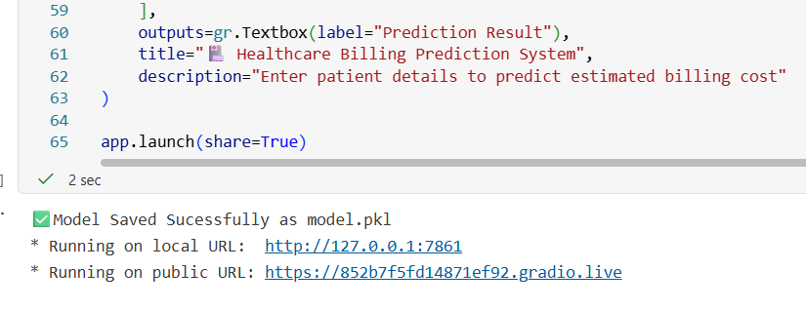
Data Analysis & Insights with ML Model Training
Analytical Techniques Used
Exploratory Data Analysis (EDA)
Statistical analysis of healthcare attributes
Feature correlation analysis
Machine Learning Regression Model
Algorithms Applied
Regression-based prediction model –Gradient Boosting Regressor
Model trained on cleaned healthcare dataset

Slide 12
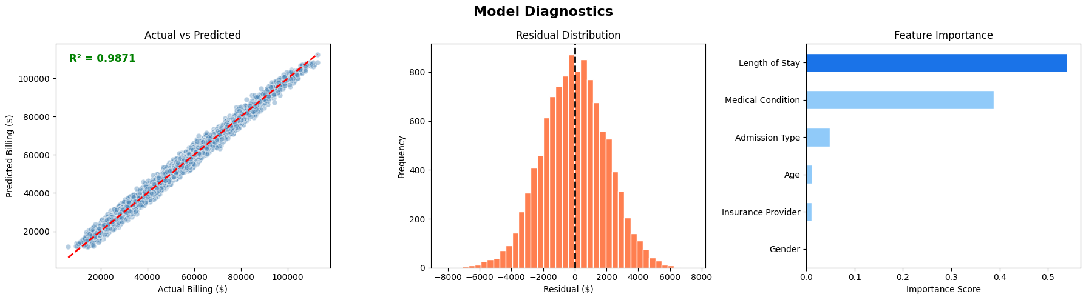

Slide 13
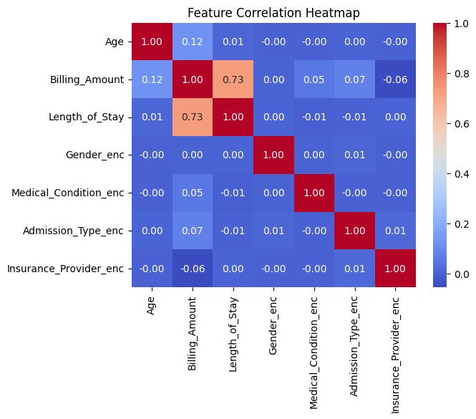
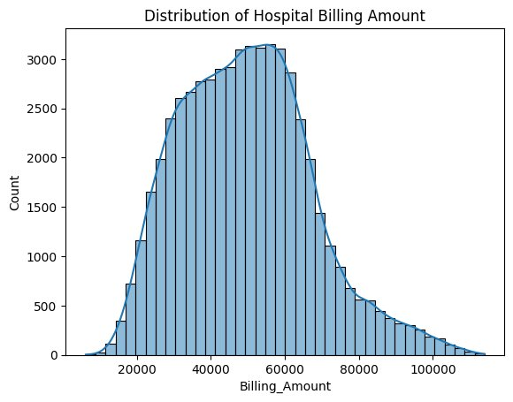
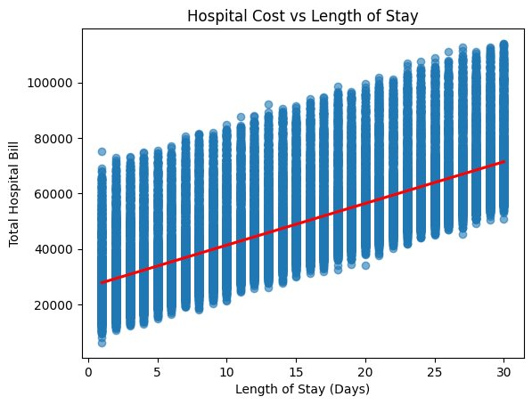
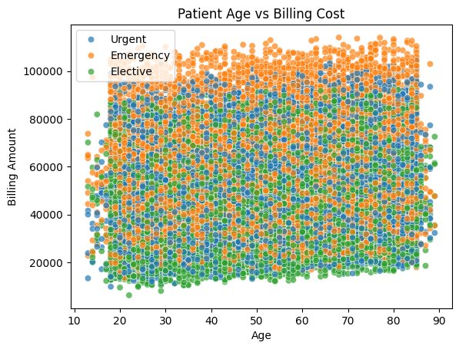
Key Insights Discovered
Length of hospital stay strongly impacts total bill
Insurance type influences billing variation
Emergency admissions increase treatment cost
Age and treatment category affect expense patterns
System helps hospitals to:
Estimate patient billing before treatment
Improve financial planning
Optimize hospital resource allocation
Increase billing transparency for patients
Patients benefit by:
Predicting treatment expenses early
Better financial preparation
Improved healthcare accessibility

Slide 14
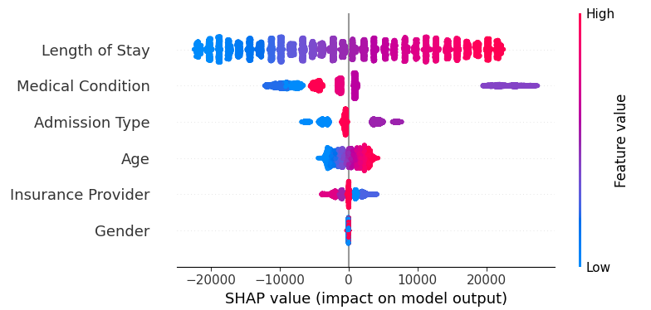
More Insights by Shap Expansive AI
Implemented SHAP Explainable AI to interpret the Healthcare Billing Prediction model and improve transparency.
Identified Length of Stay and Medical Condition as the strongest factors influencing hospital billing costs.
Analysis showed Emergency admissions significantly increase predicted treatment expenses.

Slide 15
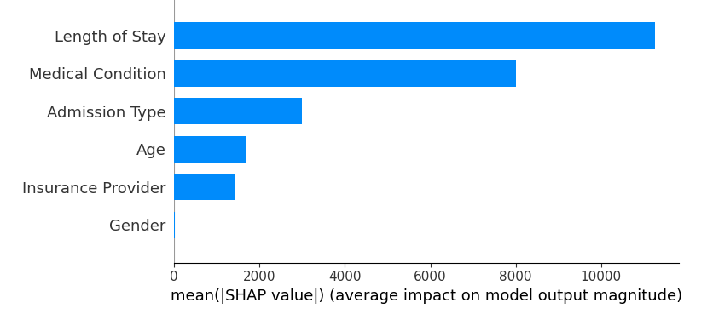
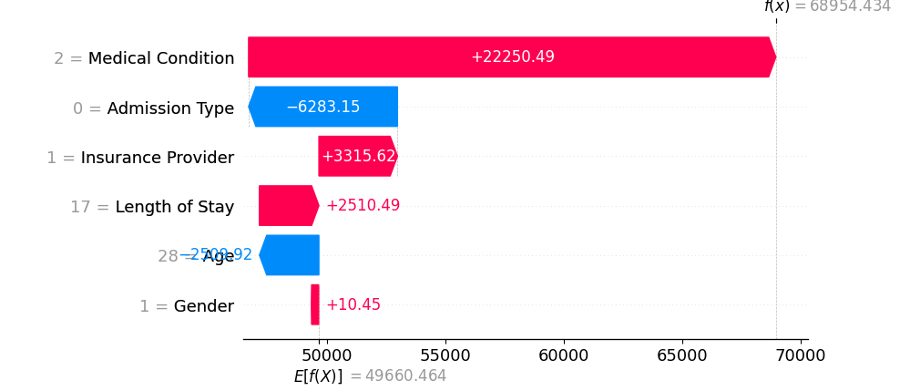
Enabled patient-level prediction explanation, showing which features increase or decrease billing amounts.
Provided actionable insights for hospital cost optimisation, insurance planning, and resource allocation.
Enhanced model reliability by transforming the system from a black-box predictor into an explainable healthcare decision support system.
🎯 Business Value
Improves trust in AI decisions
Helps hospitals justify billing estimates
Supports ethical AI adoption in healthcare

Slide 16
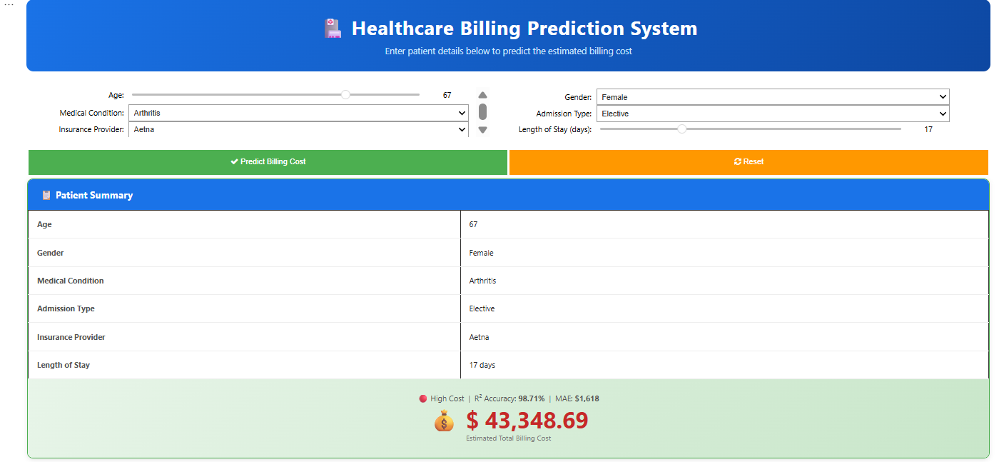
Deployment using Gradio
Innovative Solution Proposed
AI-powered Hospital Bill Prediction System
Real-time cost prediction using deployed ML model
Interactive prediction interface built using Gradio
Supports data-driven healthcare decision making

Slide 17
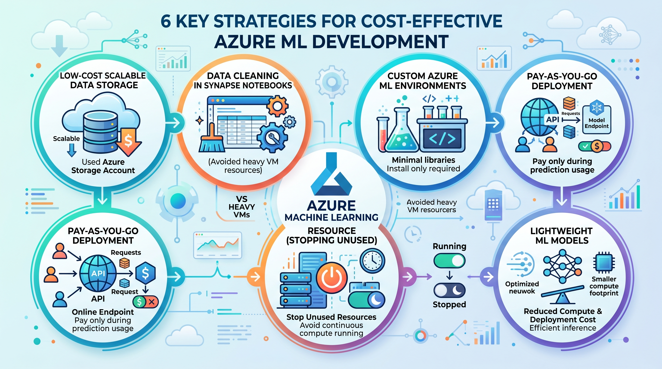
Cost Optimisation, Security & Performance Management
☁️ Cost Optimisation
Used Azure Storage Account for low-cost scalable data storage.
Performed data cleaning using Synapse Notebook instead of heavy VM resources.
Selected Custom Environment in Azure ML to install only required libraries.
Deployed model as online endpoint — pay only during prediction usage.
Avoided continuous compute running by stopping unused resources.
Lightweight ML model reduced compute and deployment cost.

Slide 18
🔐 Security & Compliance
Healthcare dataset stored securely in Azure Data Lake Storage.
Access controlled using Azure IAM & RBAC permissions.
Data transferred securely via HTTPS encrypted connections.
Model endpoint protected through authenticated Azure service access.
Ensured patient data confidentiality during training and prediction stages.
Followed cloud shared responsibility model for data protection.
📊 Performance Monitoring & Management
Used Azure ML deployment monitoring to track prediction status.
Verified model accuracy using evaluation metrics before deployment.
Monitored endpoint health using logs and scoring responses.
Optimised preprocessing pipeline for faster prediction response time.
Cloud architecture allows scaling when hospital data volume increases.
Continuous monitoring ensures reliable real-time billing prediction.

Slide 19
Final Conclusion & Future Improvements
🎯 Project Conclusion
Developed an end-to-end Hospital Billing Prediction System using Microsoft Azure Cloud.
Implemented cloud-based data ingestion, storage, and scalable processing architecture.
Applied machine learning regression model for accurate billing prediction.
Integrated Explainable AI (SHAP) to ensure transparent healthcare decisions.
Successfully deployed a real-time prediction system using Azure ML & Gradio interface.
Demonstrated practical application of Cloud Computing + Big Data + AI in healthcare.
🚀 Future Improvements
Integrate real hospital Electronic Health Records (EHR).
Enable real-time streaming data ingestion using Azure Event Hub.
Deploy mobile/web healthcare application for patient access.
Implement deep learning models for advanced prediction accuracy.
Expand system for multi-hospital cloud deployment.
Add Power BI live dashboard for hospital management analytics.

Slide 20


Slide 21
References
Kaggle (2024) Healthcare Dataset. Available at: https://www.kaggle.com/ (Accessed: 10 April 2026).
Microsoft Azure (2024) Azure Machine Learning documentation. Available at: https://learn.microsoft.com/azure/machine-learning/ (Accessed: 4 April 2026).
Microsoft Azure (2024) Azure Synapse Analytics documentation. Available at: https://learn.microsoft.com/azure/synapse-analytics/ (Accessed: 8 May 2026).
Microsoft Azure (2024) Azure Data Lake Storage Gen2 documentation. Available at: https://learn.microsoft.com/azure/storage/blobs/data-lake-storage-introduction (Accessed: 8 May 2026).
Raghupathi, W. and Raghupathi, V. (2014) ‘Big Data Analytics in Healthcare: Promise and Potential’, Health Information Science and Systems, 2(3).
Gradio (2024) Gradio documentation. Available at: https://www.gradio.app/docs (Accessed: 1 May 2026).

